Slide 1
What Kind Of Movies Should We Invest In?
An analysis by Jeffery Rosario

Slide 2
On The Basis Of What?
Profit on the basis of genre
Worldwide gross vs domestic gross
Movie release dates

Slide 3
The Data
Approximately 1000 movie titles
Mean of production budget, domestic gross, and worldwide gross were used
Genres with less than 10 movies to represent them were removed

Slide 4
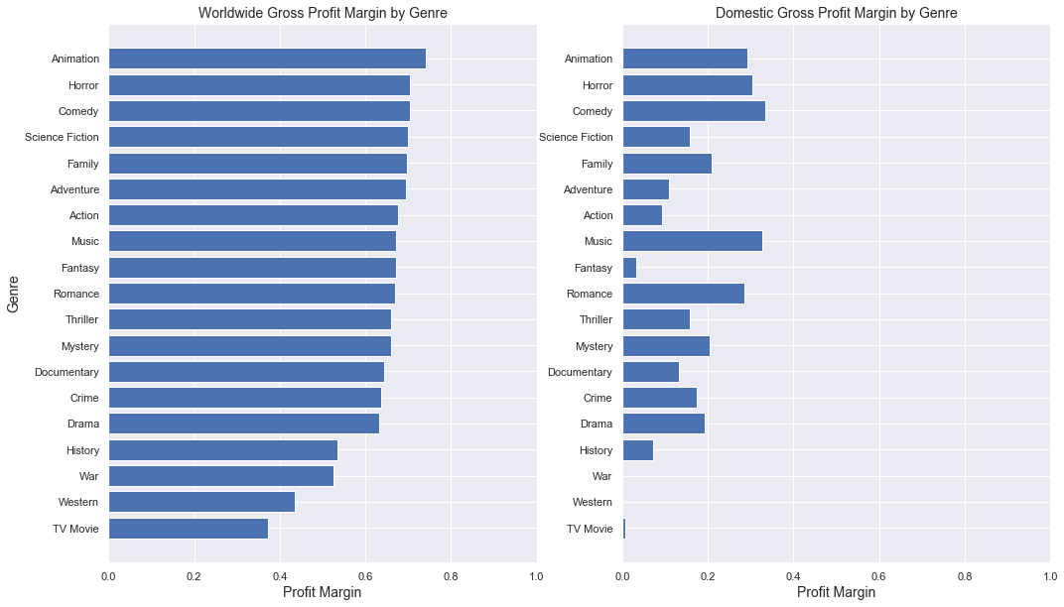
Analysis On Genres
Genres sorted by worldwide profit margin
Worldwide release > domestic release
Animation, Horror, Comedy are the top 3 genres

Slide 5
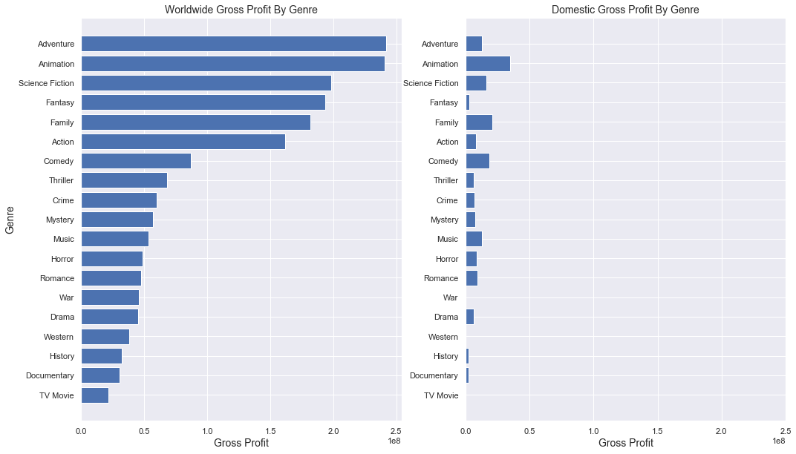
Analysis On Genres
Genres sorted by worldwide gross margin
Worldwide release > domestic release
Animation, Adventure, Science Fiction are the top 3 genres with the highest gross margin

Slide 6
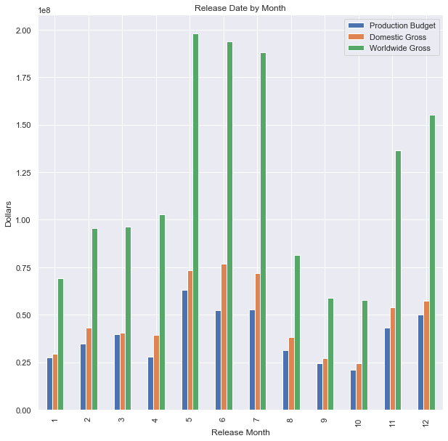
Analysis on Release Month
Highest grossing months: May, June, July, November, December
Production Costs are lower for the other 7 grossing months

Slide 7
Recommendations
To achieve a 60% profit margin refrain from History, War, Western and TV Movies
Do not limit movie releases to domestic sales.
Movies with a 25 million dollar budget should be released from August- November or January-April
Movies with a 50-75 million dollar budget should have more success releases between May-July and November-December

